Slide 1




Communication With More Confidence
Challenges and opportunities

Slide 2


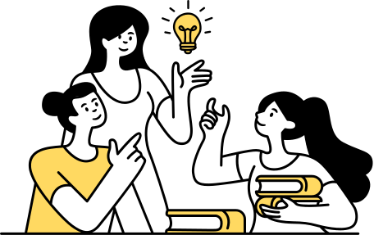
Purpose of learning communication
People are forgetting how to talk
How to listen
How to express themselve
What words to use and not to use
They lack the confidence to meet other people
or Tackle difficult situation face-to-face

Slide 3




What makes a confident communicator?
Confident communicators are self-confident have good self-esteem
They believe they are worth being listened
They like to hear the views and opinions of others
They are able to both take and give criticism without feeling inadequate and hurt

Slide 4


Benefits of confident communication
In the Workplace:
Increased productivity
Better team working
Fewer mistakes and therefore more cost saving
Less stress and conflict
Better motivation

Slide 5



How can you improve your communiction skills?
The only way to improve communication is to change the way you feel, think and act.

Slide 6

In order to communicate confidently you need to
Mature open minded personality
Ask the right questions
Listen effectively
Read and interpret body language
Understand what is being said behind the words
Use the right words
Self-confidence
Genuine interest in the other people

Slide 7
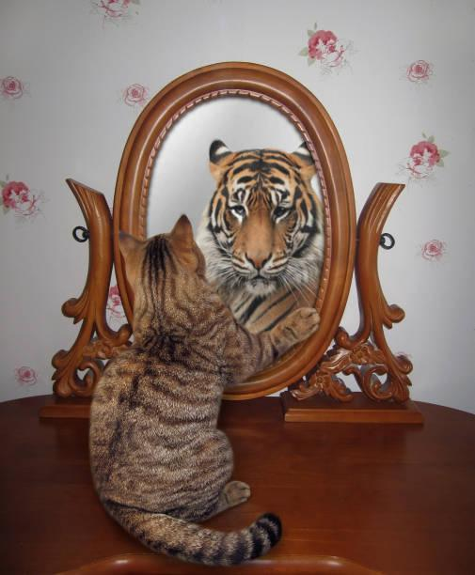
Building Confidence
Acting more confidently begins with thinking more confidently
Your brain is a very powerful organ
It sends messages people through you body language
If you think that your point of view is useless
Then this will be relayed to other people through your body language

Slide 8

How to Understand Client Personality Types
Type-A
Type-B
Type-C
Type-D
Dominance
Social
Measured
Compliant
Understanding client personality enhances communication and relationship.

Slide 9
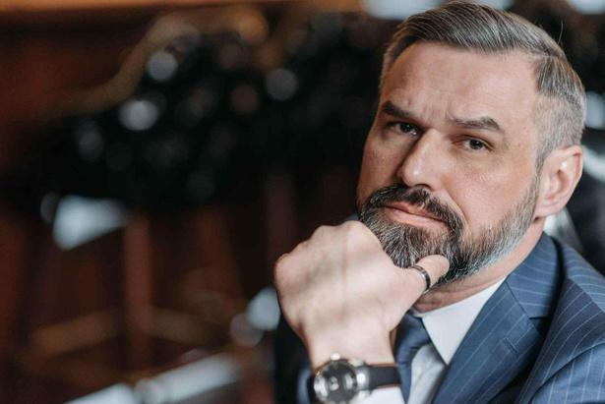
Personality Types
Have dominance and superiority in their make up
Impatient individuals
Confident decision makers
Time conscious and find it hard to relax
Have a high degree of energy, and like getting things done
They are good at ideas, and at problem solving
Their influencing style -
Tough battler, pressing for results, giving orders, issuing challenges.
Type-A
Dominance

Slide 10




Manage a Type-A Personality
You should give them short-term goals that give them a high degree of recognition and status
Try and speed up the way you talk and execute
Be direct, get straight to the point
Use time efficiently

Slide 11
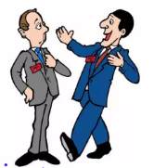
Personality Types
Likes people
They are adaptable, flexible and participative
They are enthusiastic, embracing
Come up with lots of ideas
They are not afraid of change
Their influencing style -
Friendly helper, showing concern
Try to influence by appealing to others emotions
Type-B
Social

Slide 12
Manage a Type-B Personality
Give them short to medium-term goals
Consistent management approach

Slide 13

Personality Types
Measured and far more logical and analytical
Steady, often security minded
Don't like a lot of change
Suspicious and skeptical of new ideas
They are consistent, caring and patient
They don’t like taking risks
They are generally warm hearted
Their influencing style -
Based on logic and facts
Fairness
Type-C
Measured

Slide 14
Manage a Type-C Personality
Set long-term goals with careful and periodic reviews
Prefer following assertive leaders (lead in situation)
When introducing change it is best to do it in stages
Doesn't like interruptions and distractions
They need to feel they have your support and encouragement

Slide 15
Personality Types
Comply with the rules and regulations
Very systematic, precise, hyperefficient
Love facts and details
Will use rules, authority and logical argument
Their influencing style -
based on logic and facts often
They have a tendency to correct errors and inaccuracies
Type-D
Compliant

Slide 16
Manage a Type-D Personality
They like long-term goals fully negotiated
They need a detailed brief and explanation
Do not like taking risks
Concerned with quality

Slide 17

Accept full responsibility for communication
Accept you cannot change another person
Be aware of the values, attitudes, pressures
Keep an open mind and try and see where the other person is coming from
Get a positive inner voice
Adopt and practise giving out confident body language
Fine tune your listening skills using critical listening
Understand that not everyone is like you
Final Check list

Slide 18
Thank you very much!

